Slide 1
MHV – PGHD Self Entered Data
1 March 2022

Slide 2
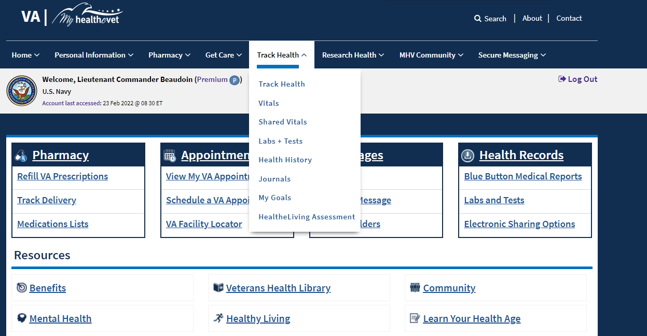

Slide 3
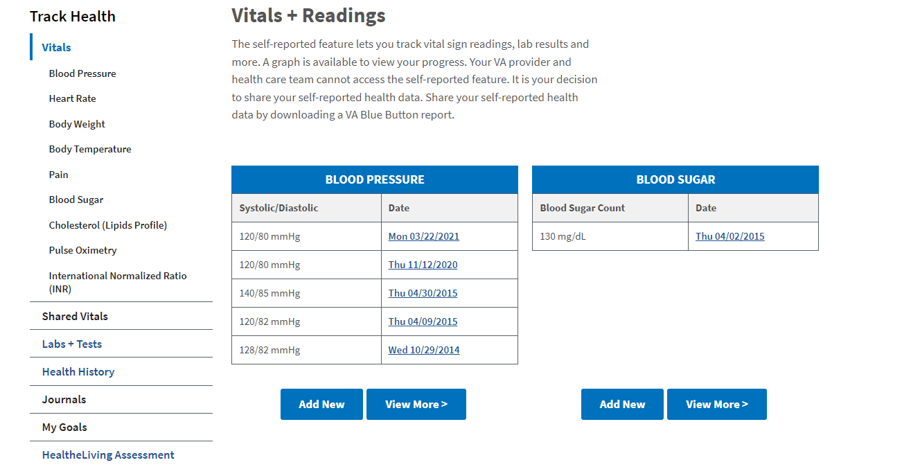
MHV Vitals – Not Shared

Slide 4
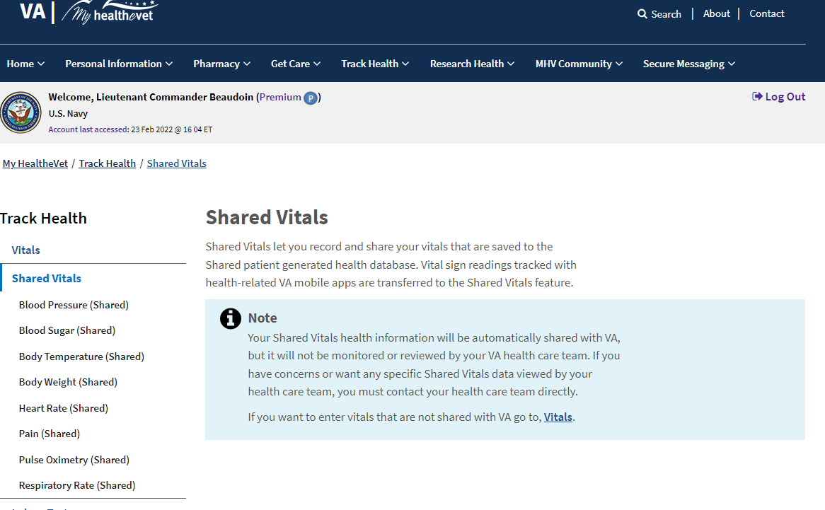
MHV to PGHD Shared Vitals – Activated 5/2/21

Slide 5
MHV Production Demo

Slide 6
Usage Analysis

Slide 7
Self Entered –not shared Usage Jan – Oct 2020
Average Unique Users/mo = 16,882
Average Records created/mo = 115,398
Top Domain Records created average/mo
BP – 31,980
Heart Rate – 21,241
Blood Sugar – 20,630
Weight – 10,643
Temp – 4,020
Pain – 3,064

Slide 8
Shared Vitals Unique Veteran Usage

Slide 9
Transactions by Vital Domain

Slide 10
MHV to PGHD Daily Unique User Transactions

Slide 11
PGHD Monthly Domain Usage
Row Labels | Blood Pressure | Blood Sugar | Body Temperature | Body Weight | Heart Rate | Pain | Pulse Oximetry | Respiratory Rate | Grand Total
5/1/2021 | 4605 | 1887 | 510 | 1578 | 1790 | 839 |  |  | 11209
6/1/2021 | 8644 | 3706 | 872 | 2894 | 3239 | 1617 |  |  | 20972
7/1/2021 | 11078 | 5902 | 1159 | 3483 | 4056 | 2049 |  |  | 27727
8/1/2021 | 14054 | 6597 | 1499 | 4461 | 5544 | 2580 | 4 |  | 34739
9/1/2021 | 15792 | 7203 | 1750 | 5026 | 6449 | 3148 | 52 |  | 39420
10/1/2021 | 14765 | 6676 | 1768 | 4750 | 6291 | 3034 | 46 | 47 | 37377
11/1/2021 | 15231 | 6808 | 1770 | 5087 | 6590 | 2915 | 660 | 270 | 39331
12/1/2021 | 14937 | 6374 | 1727 | 4881 | 6478 | 2618 | 1665 | 713 | 39393
1/1/2022 | 16656 | 6683 | 2231 | 5503 | 7165 | 2860 | 2180 | 776 | 44054
Grand Total | 115762 | 51836 | 13286 | 37663 | 47602 | 21660 | 4607 | 1806 | 294222

Slide 12
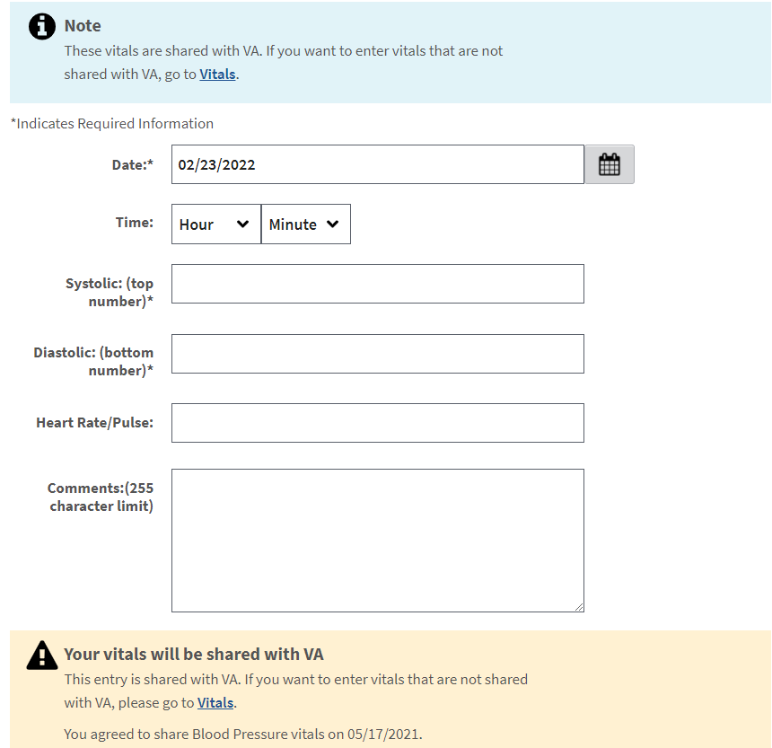
Blood Pressure

Slide 13
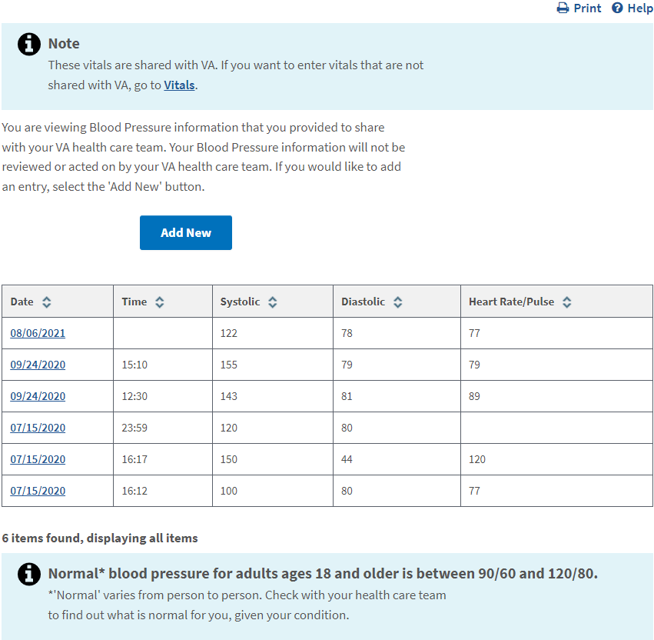

BP Data Detail

Slide 14
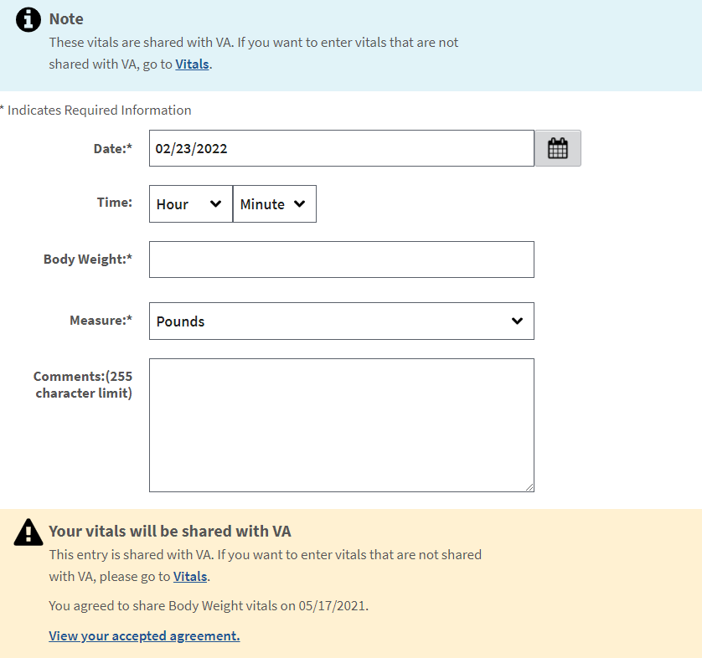
Heart Rate

Slide 15
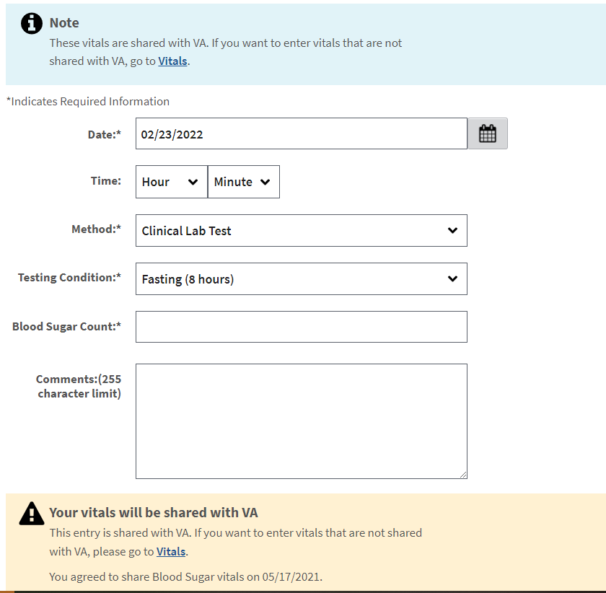
Blood Sugar

Slide 16
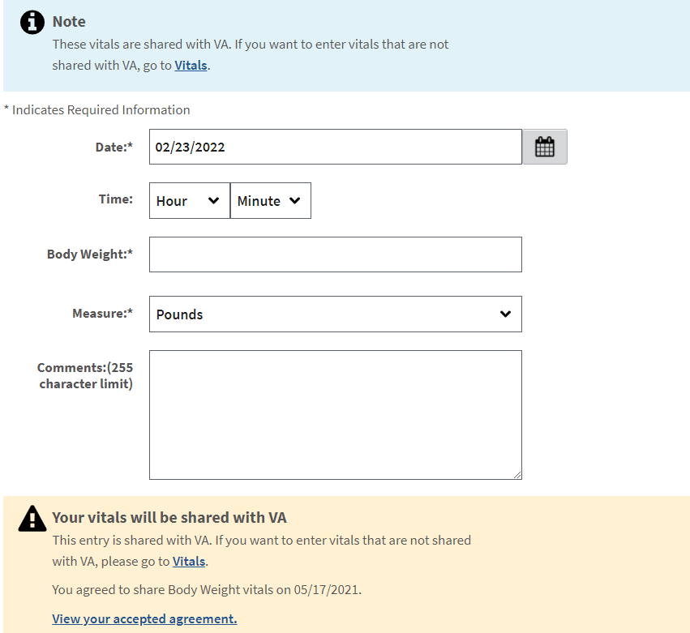
Body Weight

Slide 17
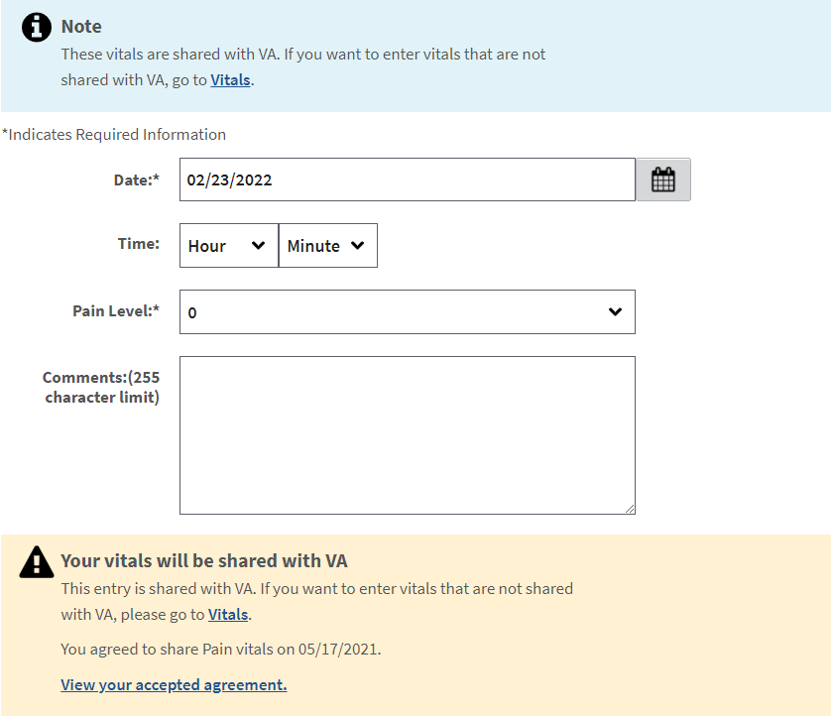
Pain

Slide 18
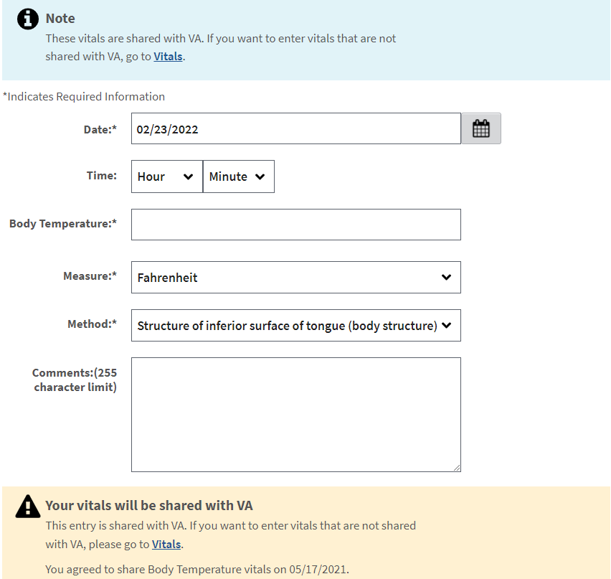
Body Temperature

Slide 19
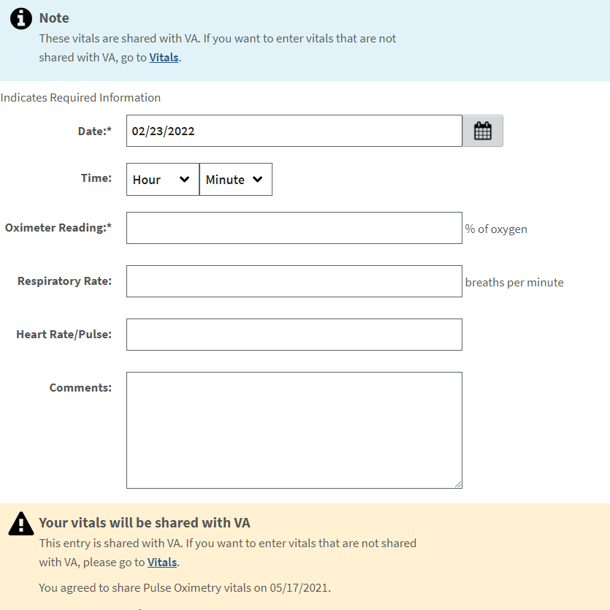
Pulse Oximetry

Slide 20
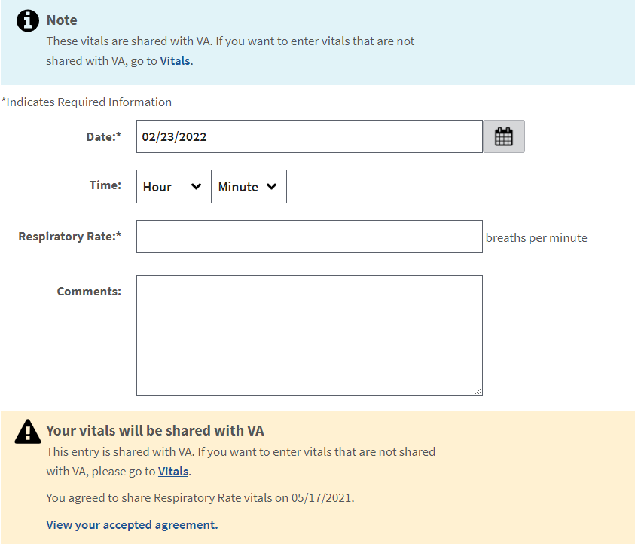
Respiratory Rate

